Slide 1
I am wiser than this man, for neither of us appears to know anything great and good; but he fancies he knows something, although he knows nothing; whereas I, as I do not know anything, so I do not fancy I do. In this trifling particular, then, I appear to be wiser than he, because I do not fancy I know what I do not know.
Socrates

Slide 2
How long is the DNA in your nucleus?

Slide 3
Answer
Every nucleus in the human body has DNA that is 6 feet long.

Slide 4
Best Practices in Biology
Julio Miguez

Slide 5
Let’s Go Around the Room
Introduce Yourself
What is your name?
What school do you currently teach at?
How many years have you been teaching?

Slide 6
My Contact Information
Julio Miguez
Highland Oaks Middle School
Biology and Physical Science
jmiguez@dadeschools.net
(305) 932-3810

Slide 7
Teaching Philosophy
Be fair & care

Slide 8
Beginning of the Year

Slide 9
Mr. Miguez’s Classroom Rules

Slide 10
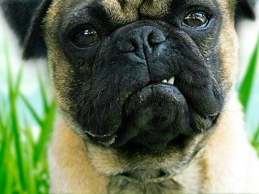
Follow directions the first time given

Slide 11
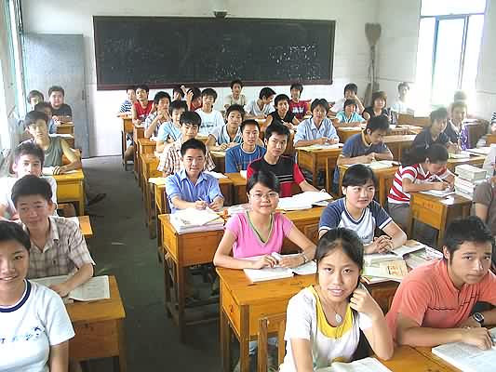
Be in your seat and ready to work when the late bell rings

Slide 12
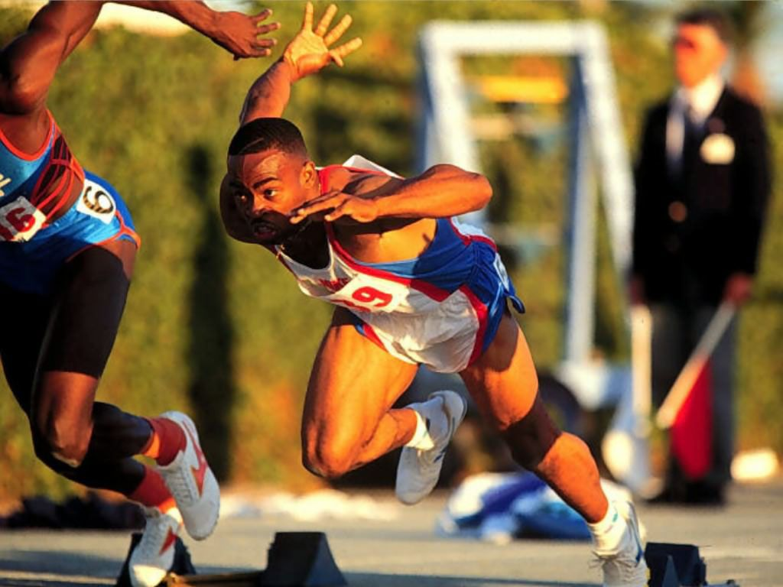
Start the do now work immediately

Slide 13
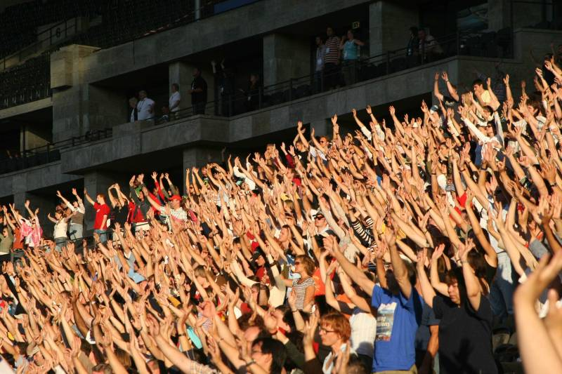
Raise hand to speak so only one person is speaking at the same time.

Slide 14
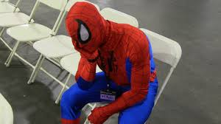
Stay in seat at all times

Slide 15
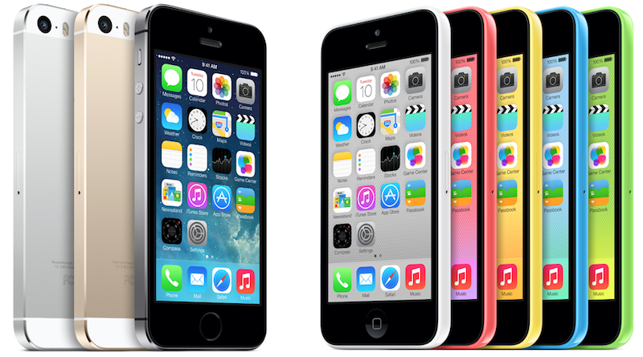
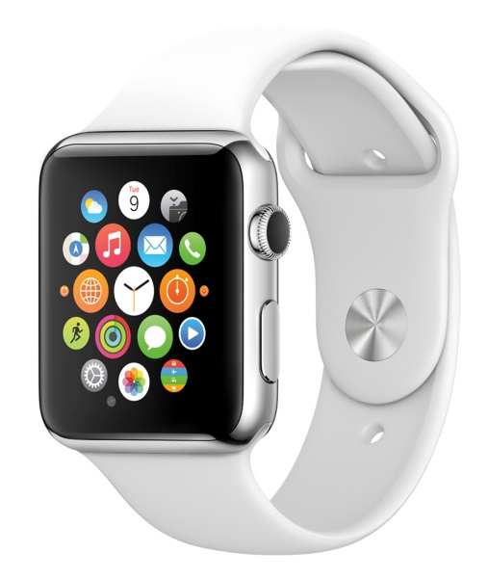
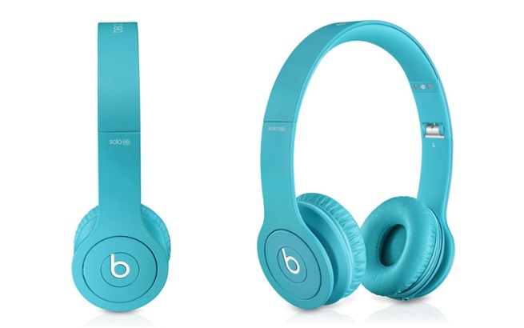
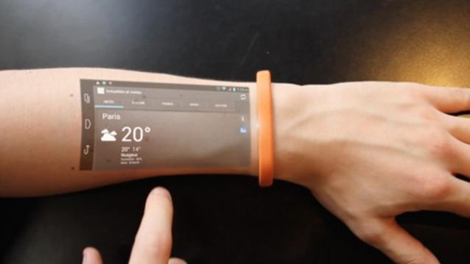
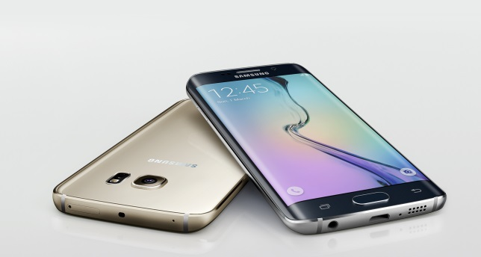
No IPOD or Cell Phone Use

Slide 16
No Food OR DRINKS in the Class room

Slide 17
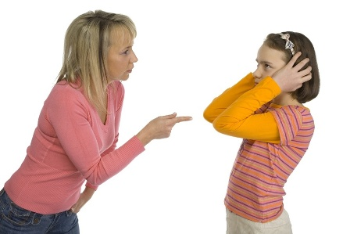
Consequences
Warning
Parent Contact / Detention
Referral to Team Leader
Referral to Student Services
Referral to Administrator

Slide 18
Required Materials
Pen /pencil &paper
A three ring binder with pockets dividers with three tabs:
1) Do Now 2) Chapter Outlines 3) Home Learning & Class Work
Bound composition notebook 9.75 X 7.5 with at least 100 sheets

Slide 19
Req’d Materials Cont’d
A USB Flash Drive with at least 2 GB
School Agenda

Slide 20
Computer and Internet Access
If you do not have one or the other, have your parents contact me.

Slide 21
Grading Policy
GRADE SCALE
A (90-100) B (80-89) C (70-79) D (60-69)
F (59 OR LOWER)
Binder Checks worth 4 Grades
Tests worth 5 Grades

Slide 22
Late Work Policy
Home learning ( Home Work) is due at the beginning of the period. Anything turned in after taking attendance is late.
1 letter grade will be deducted for each day late.

Slide 23
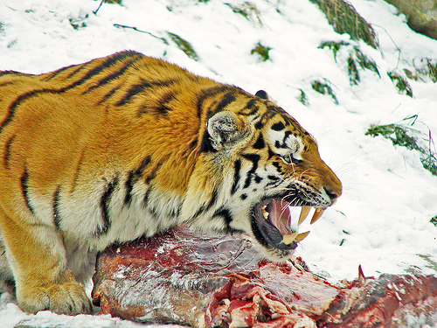
Academic Honesty
Cheating of any kind will not be tolerated. All parties involved in academic dishonesty will receive a ZERO for the assignment or test and be subject to further sanctions according to the Tiger Team’s policy.

Slide 24
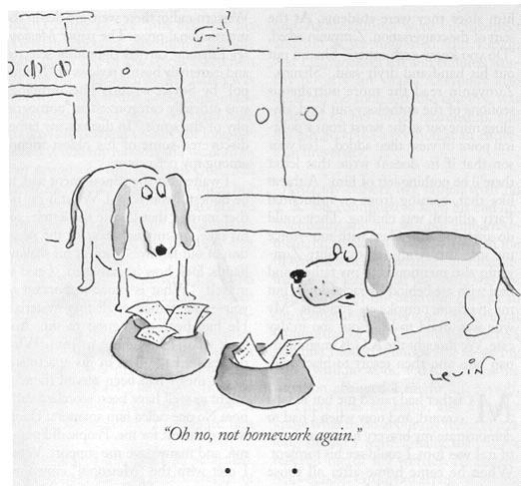

Slide 25
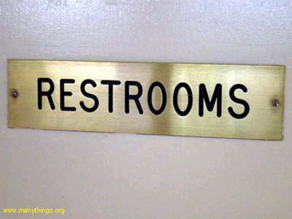
Restroom Policy
Use restrooms during class change time

Slide 26
When in doubt of the rule or procedure governing anything or anyone related to or in this classroom, abide by the following: Ask the teacher, be courteous and be respectful.

Slide 27
If the wind will not serve, take to the oars. Destitutus ventis, remos adhibe Latin Proverb

Slide 28
Lets Have a Great Year!

Slide 29
A Day in My Classroom

Slide 30
First Day of the Week
Students are to copy their home learning assignments for the week.

Slide 31
Bell Ringer “ Do Now”
I pull an objective from the chapter and students need to answer in paragraph form.
( 5 Sentences)

Slide 32
Outlines
All students outline the chapters by hand.
They highlight vocabulary so we can kill 2 birds with one stone.
They have a minimum of one sentence per paragraph.
Instructions are to read the paragraph and write down the main point.
I regularly allow them to cheat by allowing them to use their binder work ( including outlines) for 5 minutes.

Slide 34
Lecture
I go over the answer to the bell ringer by asking different students to read their do now.
We immediately start discussing chapter sections.
I usually show the corresponding PowerPoint from the book's resource cd or one of my own.
Students ask questions.

Slide 35
Assessment
Once we finish covering a chapter, I assess students understanding by giving them a chapter test.
Test are usually 25-33 questions long.
I use the question bank provided by examview.
I select questions that we have discussed.
I mix it up by sometimes giving them a 50 question test, throwing in true/false questions and the occasional essay question.
Upon grading the test, we go over the answers.

Slide 36
Labs
I have students write up labs in their lab notebook.
Although they work in groups, they each must produce their own work using shared data.
Labs always have a data table and graph.
Dissections are done after the EOC exam.
I usually do the Earthworm and the Frog.

Slide 37
Projects
Students must produce and turn in a science fair project on a board.
We have an internal science fair night where all projects are showcased and winners are invited to present their project.
We usually register over 10 projects.
You guessed it. I am the science fair liaison for the school.
My students also do semester projects like the cell model, dna model, and meiosis & mitosis .

Slide 38
Resources

Slide 39
Data Chats
Data chats begin after the return of baseline data.
Each student receives a print out of the bench marks they did not do well on.
Escambia county review form is given at the same time so they can review the benchmark missed.
http://www.ecsd-fl.schoolloop.com/biologyeocreview

Slide 40
Your Best Friend for EOC Review
http://www.ecsd-fl.schoolloop.com/biologyeocreview

Slide 41
Biology Pacing Guide

Slide 42
Pacing Guide et al.
http://science.dadeschools.net/teachers.htm

Slide 43
Florida Standards Assessments (FSAs)
End-of-Course (EOC) Assessments
http://www.fldoe.org/accountability/assessments/k-12-student-assessment/end-of-course-eoc-assessments/

Slide 44
Item Specifications
http://www.fldoe.org/core/fileparse.php/5662/urlt/0077547-biologyfl11sp.pdf

Slide 45
BREAK 10 Min

Slide 46
Activity
NOS ( Nature of Science) Puzzle
What is Science?

Slide 47
Let’s Share Lesson Plans
I will assign you a topic from the “Year at a Glance” pacing guide. Give me a short lesson plan for that topic. Write your name and school on the back of the paper. I will scan them to my website:
www.miguezscience.com
They will be placed in a file called lesson plans under the Science Fair tab.

Slide 48
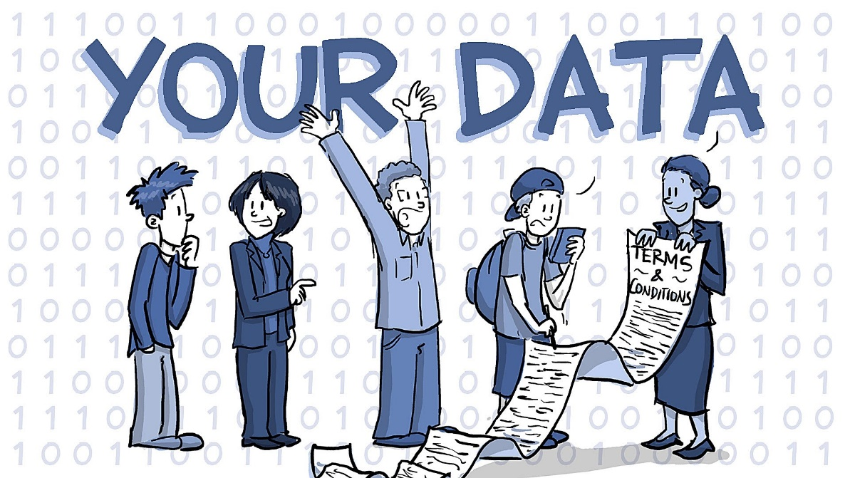
Data Driven Instruction
Thinkgate Data
After each topic test, I analyze data for remediation.
The reports I focus on most:
Progress Report
Distractor Analysis

Slide 49
Thinkgate - Progress Report

Slide 50
Thinkgate – Distractor Analysis Report

Slide 51
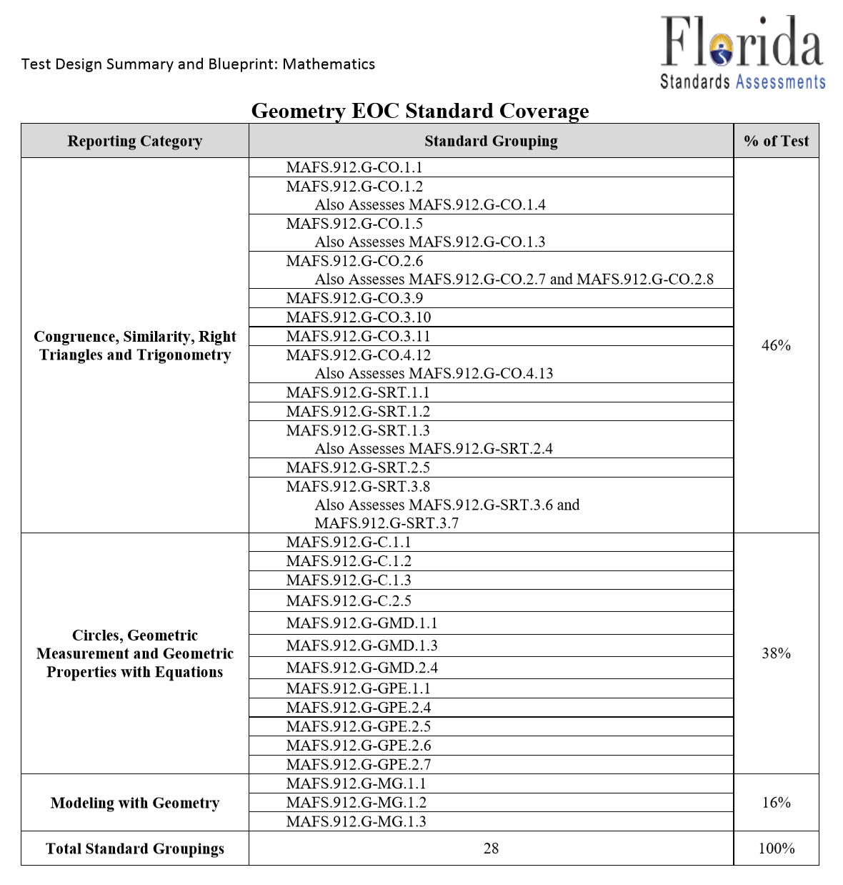
End-of-Course (EOC) Exam Review
To review for the EOC:
Edgenuity Blittzes are coordinated about a week before the exam
Saturday School tutoring

Slide 52
Share Your Best Practices
List 10 of your biology best practices

Slide 53
Gallery Walk

