Slide 1
Chapter 1:
The Scope of Biology
By Mr. Miguez

Slide 2
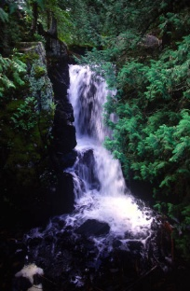
1.1 Biology explores life from the global to the microscopic scale.
Biosphere: all parts of the planet that are inhabited by living things.
Ecosystem: the community of living things in an area along with the nonliving features that support the community.
The rainforest and the desert are examples of different ecosystems.
Ecosystems vary widely. Each has a different community of living things and different nonliving features.
Organism: living thing.
Microorganism: organisms too small to see, example microscopic organisms in the soil are responsible for decomposing the leaf liter and other wastes on the woodland floor.
Ecosystems are dynamic, or constantly changing because of the interactions of organisms in the community.

Slide 3
Cells: are life’s basic units of structure and
function. All organisms are made up of one or more cells.
DNA: the chemical responsible for inheritance- the passing of traits
From parent to their offspring.
Gene: unit of inherited information in DNA.
Examples of genes that you have inherited: eye color, hair color, curly/
Straight hair, shape of ears, hairline…….
There are many genes on one length
of DNA.

Slide 4

1-2 Biology explores life in its diverse forms
Species: a distinct form of life.
1.5 million have been identified so far.
Insects are the most diverse of all animals.
Classifying life: Organisms are put into different categories based on their similarities and differences.
Kingdom→Phylum→Class→ Order→ Family→ Genus→ Species
Domain: broadest category for classifying life forms.
Unicellular: consisting of only one cell.
Most bacteria are unicellular, so are many protists and certain fungi.
Prokaryotic cell: cells without nuclei.
Only from the Domain Bacteria and the Domain Archae.
Eukaryotic cell: contain nuclei that separate DNA from the rest of the cell.
Multicellular: organisms made up of many cells.
found in the four kingdoms: Protists, Fungi, Plants, and Animal- Domain Eukarya
Your body has trillions of cells.

Slide 5
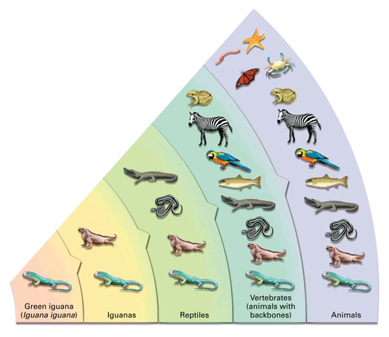
Figure 1-6 Classifying Life
A green iguana (Iguana iguana) shares many characteristics with other species of iguanas, but fewer with other reptiles such as snakes or alligators. As categories of organisms become broader, the organisms in the category are more diverse.

Slide 6
1.3 Ten Themes unify the study of life
1.)Biological Systems: have properties that are based on the arrangement and interactions of its parts.
You are more than just a sum of your parts (brain needs the nervous system).
Example: Muscles are coordinated by signals from the brain, carried by nerves.
Tissues: Layers of Cells (01:25) Organs: Organized Tissues (01:28)
2.) Cells are the basis for life- cells are organized into higher levels of organization An Overview of the Structure of Living Things (01:59)
Example:
Nerve cell→ Nerve tissue→ Organ (brain)→ Nervous system
3.) Form fits function- how something works is related to its structure.
A bird’s wing is light and aerodynamic. The structure of the birds bones contribute to its ability to fly. Birds of Prey (05:12) talons- help kill prey

Slide 7
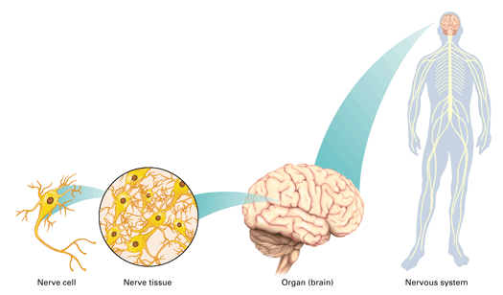
Figure 1-10
The human body, like most multicellular organisms, consists of many levels of organization

Slide 8
4.) Reproduction and Inheritance:
“like begets like”
A Labrador puppy will grow up and look similar to its Labrador parents.
Genes are responsible for family resemblance. Breeding Canaries for Specific Traits in Offspring (03:45)
Egg + sperm → Fertilized egg → Cells → Organism
(both nuclei contain DNA) (DNA from both parents) (w/ copies of inherited DNA) w/ traits from both parents

Slide 9
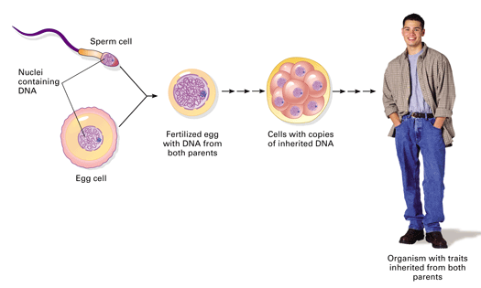
Figure 1-13
When an egg cell and sperm cell fuse, DNA from each parent is combined in the fertilized egg. The inherited DNA directs the eventual transformation of the fertilized egg into a person.

Slide 10
5.)Interaction with the Environment- no organism is completely isolated from its surroundings.
Photosynthesis: Plants use water and nutrients from the soil, carbon dioxide from the air, and energy from the sun to make food. Plants also release oxygen as a byproduct. Interaction Between Desert Plants and Animals (01:11)
The plants also impact the environment by breaking up rocks as its roots grow, and releasing acids that change the soil.
You breathe oxygen and exhale carbon dioxide. You eat food and get rid of waste products. Living requires a daily balance of these inputs and outputs.
6.) Energy and Life- Life’s activities require organisms to perform work, which require energy. Requirements for Life: Energy: The Sun (00:53)
You obtain your energy in a chemical form from the foods you eat (sugars, fats, proteins). Energy Transfer: Producers and Consumers (01:48
Cells use this energy for their work. You burn fuel to digest, to move, to think and keep your heart beating while you are asleep. Energy Transfer: Decomposers and Detritus Feeders
Energy flows into an ecosystem as sunlight and exits it in the form of heat.

Slide 11
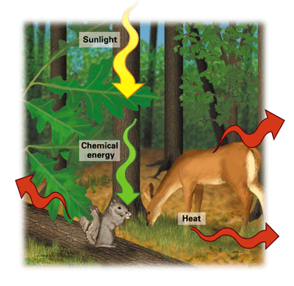
Figure 1-15
Energy enters an ecosystem as sunlight. Plants are producers that convert light energy to chemical energy stored in food. Animals and other consumers obtain their energy in chemical form by eating. Energy exits an ecosystem as heat, which all organisms generate as they perform work.

Slide 12
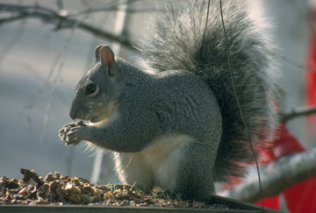
Producer: plants and other photosynthetic organisms produce their own food upon which the entire ecosystem depends.
Consumer: animals and other organisms that eat (consume) the food made by the producers.
All organisms loose energy in the form of heat. An ecosystem can not recycle energy. All life depends on a continuous supply of energy from the sun.
7.) Regulation- ability of an organism to regulate their internal conditions.
Sweating and panting are examples of cooling mechanisms that help people and animals regulate their body temperatures. Metabolism and Homeostasis (05:02)
Homeostasis: “steady state”
Mechanisms of homeostasis enable organisms to regulate their internal environment despite changes in their external environment.

Slide 13
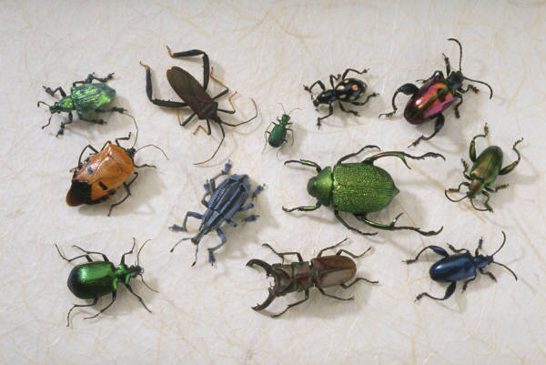
8.) Adaptation and Evolution
Adaptation: an inherited trait that helps the organism’s ability to survive and reproduce in a particular environment. (ex. Shape and color help mantids blend in with their surroundings)
Population: a localized group of organisms belonging to the same species. (Ex. in a beetle population there are different colors)
Natural Selection: process by which individuals with inherited characteristics well-suited to the environment leave more offspring than do other individuals. (Bird capture light beetles, dark beetles survive and reproduce, dark beetles become more frequent)
Evolution: “ a process of change”, generation-to-generation change in a population. (darker genes are more common, so the beetle population is evolving)

Slide 14
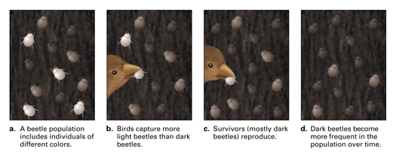
Figure 1-19
In this hypothetical example of natural selection, darker beetles are more likely to survive longer and reproduce, passing their genes on to more offspring.

Slide 15
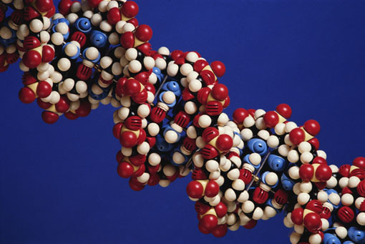
9.) Biology and Society:
People apply biology in many ways.
New finding about DNA affect medicine and agriculture.
Study of evolution helps health professionals understand how disease- causing bacteria become resistant to drugs.
Environmental awareness changes how people think about their resources and the earth.
Stem cell research, animal cloning, genetically modified crops… are all hot topics relating to biology that you can read about or hear about on the news.

Slide 16
10.) Scientific Inquiry: involves asking questions about nature and then using observations or experiments to find possible answers to those questions.
P. 19 Fitting a loggerhead turtle with a radio transmitter in order to monitor the animal throughout its range. It will help biologists determine how large a nature preserve must be to support a population of loggerhead turtles.

