Slide 1
Chapter 5 Population Ecology
5.1 Population Dynamics
1

Slide 2
Vocab 5
https://www.weather.com/
Population Density
Population Distribution
Age structure
Immigration
Emigration
Exponential Growth
Logistic Growth
Carrying Capacity
Limiting Factor
Density-dependent limiting factor
Density independent limiting factor
Demography
demographic transition
2

Slide 3
Population Characteristics
Population Density: number of organisms per unit area
Spatial distribution: the dispersion or pattern of spacing of organisms
RANDOM
UNIFORM
CLUMPED
3

Slide 4
Principles of Population Growth
Population growth rate: explains how fast a given population grows.
Population growth measured in different ways:
Microorganisms- how fast population grows in tube or bottle
Plants/animals- how fast population grows in a new environment with plenty of resources
4

Slide 5
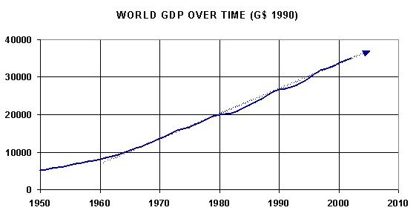
How Fast Do Populations Grow
Usually not linear
5

Slide 6
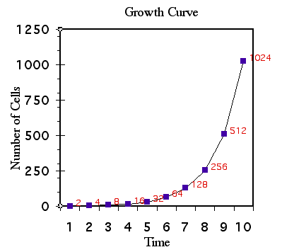
How Fast Do Populations Grow
Usually slow at first
Called a “J”-shaped curve
Slow at first because number of reproducing organisms is small
Called exponential growth: as a population gets larger it grows faster
6

Slide 7
Limits of the Environment
Population growth usually stops due to lack of resources
Food
Water
Shelter
Space
Population growth usually stops due to build up of waste products which poison the organisms
7

Slide 8
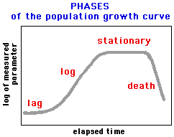
8

Slide 9
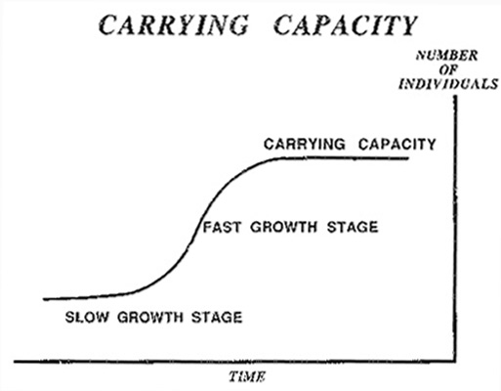
Carrying Capacity
Number of organisms of one species that an environment can support
“S”-shaped growth
9

Slide 10
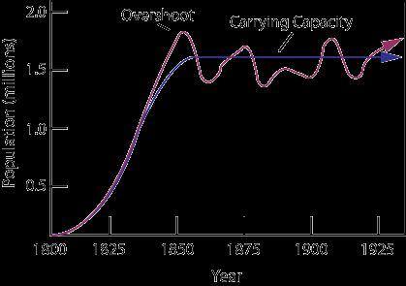
Carrying Capacity
Fluctuations above and below carrying capacity are normal
10

Slide 11
Patterns of Population Growth
Do population have a “J”-shaped population growth pattern or a ”S”-shaped population growth pattern?
Depends on organism’s reproductive pattern
In nature there is a continuum (range) of population growth patterns from “J”-shaped population growth pattern to ”S”-shaped population growth pattern
11

Slide 12
“J”-shaped population growth pattern
Also called “r” strategists
Mosquito, bacteria
Reproduce very rapidly, produce many off spring in short period of time
Environment unpredictable and change rapidly
Small body size, mature rapidly, reproduce early, short life span
Populations increase rapidly then decline
12

Slide 13
”S”-shaped population growth pattern
Also called “k” strategists
Slow rate of reproduction, produce few offspring
Elephants, bears, whales, redwood trees, cacti
Live in stable environment
Large, reproduce and mature slowly, long-lived
Maintain population size near carrying capacity
13

Slide 14
Environmental Limits to Population Growth
Limiting Factors: biotic or abiotic factors that regulate size of a population
Two types of limiting factors
Density dependent factors
Density independent factors
14

Slide 15
Density Dependent Factors
Increasing effect as population size increases
Disease
Competition
Parasites
Food
The more dense the population the faster disease can spread
Big problem in agricultural crops
15

Slide 16
Density Independent Factors
Affect all populations regardless of their density
Most are abiotic factors
Temperature
Floods
Storms
Drought
Habitat destruction
Pollution
16

Slide 17
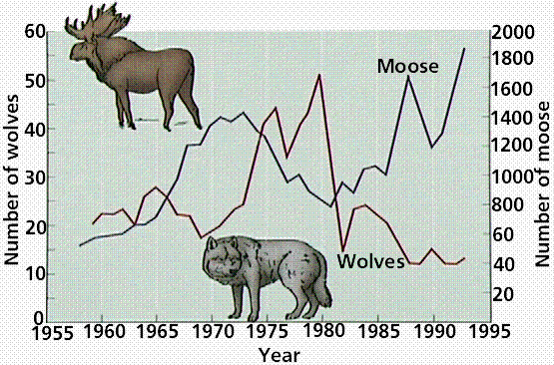
Organisms Limit Their Population Size
Predation affects population size
Predator prey relationships often show a cycle of population increases and decreases over time
17

Slide 18
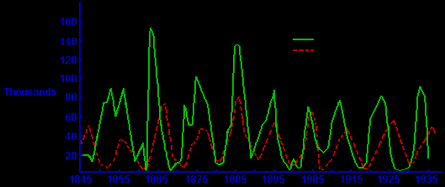
Predator Prey Relationships
Hare
Lynx
18

Slide 19
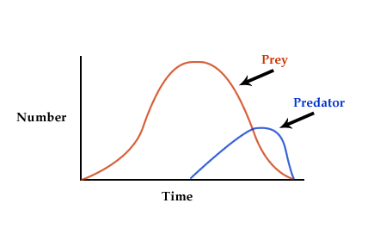
Predator Prey Relationships
Important for health of natural population
Usually young, old or injured are caught
19

Slide 20
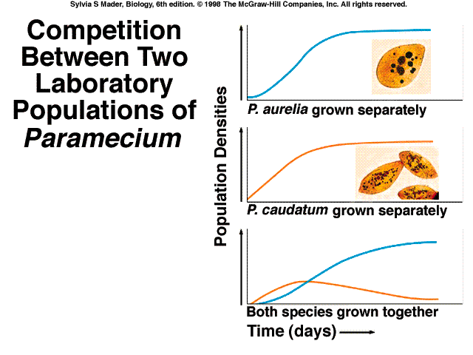
Effects of Competition
Competition for food, water, territory are density dependent factors
Only the best suited to the environment survive
20

Slide 21
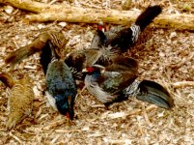
Effects of Crowding and Stress
Crowding causes stress
Aggression
Decrease in parental care
Decrease in fertility
Decrease in resistance to disease
Can lead to decrease in population size
21

Slide 22
Chapter 5 Population Biology
5.3 Human Population
22

Slide 23
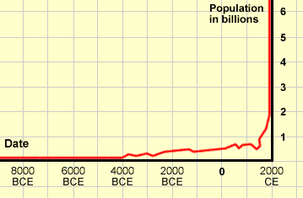
Demographic Trends
Human Population
23

Slide 24
Human Population
Demography: study of human population growth characteristics
Humans keep pushing up the carrying capacity by:
eliminating competing organisms
increasing food production
controlling disease organisms
What is the carrying capacity for humans?
24

Slide 25
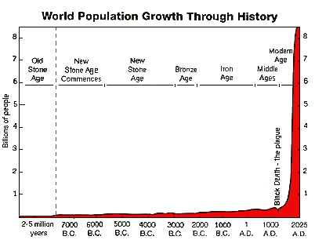
25

Slide 26
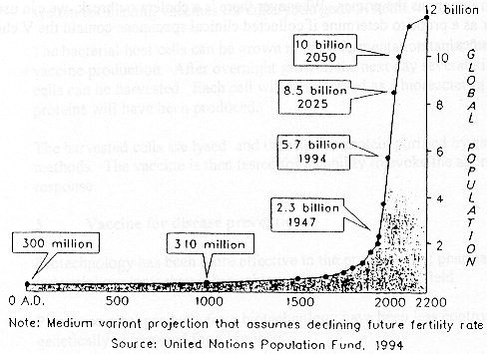
26

Slide 27
Effects of Birth and Death Rates
Population growth = birth rate – death rate
Demographic transition is when there has been a change from high birth rate and death rates to low birth rates and death rates.
In many industrialized nations decreasing death rates are more a factor than increasing birth rates (life expectancy keeps increasing)
Zero population growth exists when birthrate equals death rate.
27

Slide 28
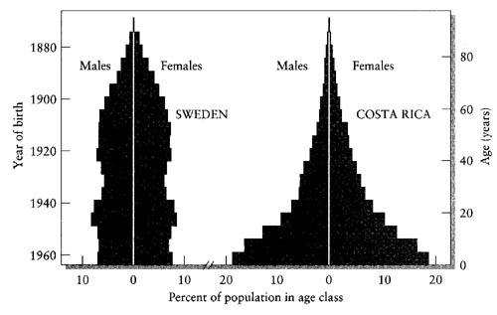
Age Affects Population Growth
28

Slide 29
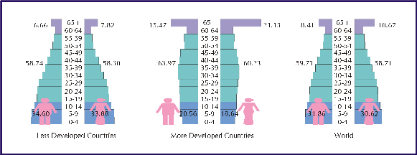
Age Structure Diagrams
Used to predict population growth
29

Slide 30
Mobility and Human Population Growth
Immigration: movement of individuals into a population
Emigration: movement of individuals out of a population
Immigration and emigration have no change in world population but can change numbers of individuals in nations, regions or cities
Useful for planning
30

