Slide 1
SCIENCE DEPARTMENT DAY 5
TOPIC 1

Slide 2
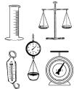
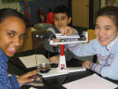
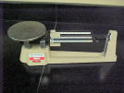
MASS AND WEIGHT

Slide 3
DEFINITIONS
Mass- the amount of matter an object has.
Matter- something that has mass and takes up space.
Weight- is the amount of mass of an object, it is dependent upon gravity.

Slide 4
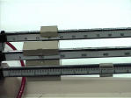
Units for Measuring Mass
Mass is measured in grams and kilograms.
1 paper clip= 1 gram
1000g=1 kilogram
The average human adult weighs 75kg.

Slide 5
Tools for Measuring Mass
**The Triple Beam Balance is the
tool we use to measure mass.

Slide 6
TOPIC 2: Classification

Slide 7
Species of Organisms
There are 13 billion known species of organisms
This is only 5% of all organisms that ever lived!!!!!
New organisms are still being found and identified

Slide 8
What is Classification?
Classification is the arrangement of organisms into orderly groups based on their similarities
Classification is also known as taxonomy
Taxonomists are scientists that identify & name organisms

Slide 9
Benefits of Classifying
Accurately & uniformly names organisms
Prevents misnomers such as starfish & jellyfish that aren't really fish
Uses same language (Latin or some Greek) for all names
Sea”horse”??

Slide 10
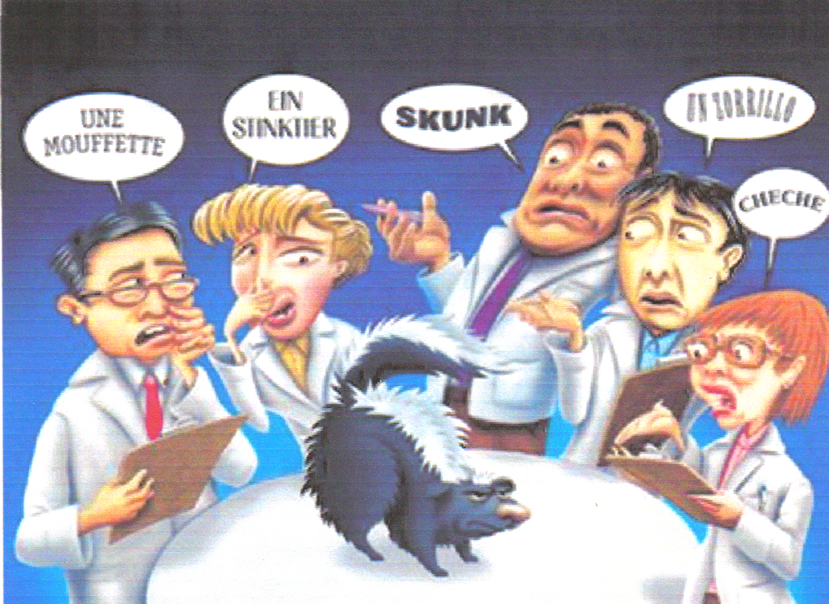
Confusion in Using Different Languages for Names

Slide 11
Latin Names are Understood by all Taxonomists

Slide 12
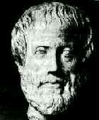
Early Taxonomists
2000 years ago, Aristotle was the first taxonomist
Aristotle divided organisms into plants & animals
He subdivided them by their habitat ---land, sea, or air dwellers

Slide 13
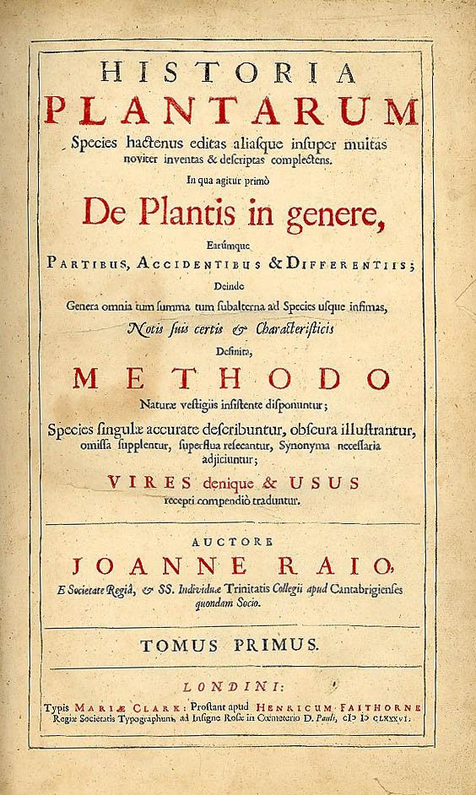
Early Taxonomists
John Ray, a botanist, was the first to use Latin for naming
His names were very long descriptions telling everything about the plant

Slide 14
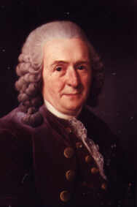
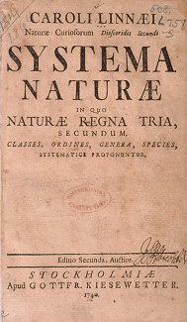
Carolus Linnaeus 1707 – 1778
18th century taxonomist
Classified organisms by their structure
Developed naming system still used today

Slide 15
Carolus Linnaeus
Called the “Father of Taxonomy”
Developed the modern system of naming known as binomial nomenclature
Two-word name (Genus & species)

Slide 16
Standardized Naming
Binomial nomenclature used
Genus species
Latin or Greek
Italicized in print
Capitalize genus, but NOT species
Underline when writing
Turdus migratorius
American Robin

Slide 17
Binomial Nomenclature
Which TWO are more closely related?

Slide 18
Rules for Naming Organisms
The International Code for Binomial Nomenclature contains the rules for naming organisms
All names must be approved by International Naming Congresses (International Zoological Congress)
This prevents duplicated names

Slide 19
Classification Groups
Taxon ( taxa-plural) is a category into which related organisms are placed
There is a hierarchy of groups (taxa) from broadest to most specific
Domain, Kingdom, Phylum, Class, Order, Family, Genus, species

Slide 20
Hierarchy-Taxonomic Groups
Domain
Kingdom
Phylum (Division – used for plants)
Class
Order
Family
Genus
Species
BROADEST TAXON
Most Specific
Notes:
Genus and species are the two names used to identify specific organisms in the binomial system of classification. Division is used for plants.

Slide 21
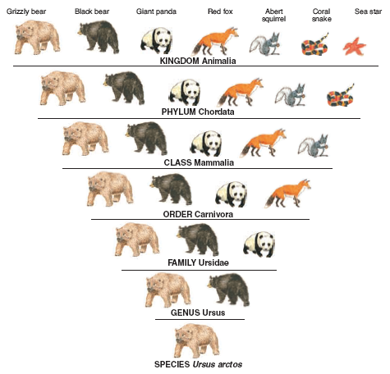
Dumb
King
Phillip
Came
Over
For
Gooseberry
Soup!

Slide 22
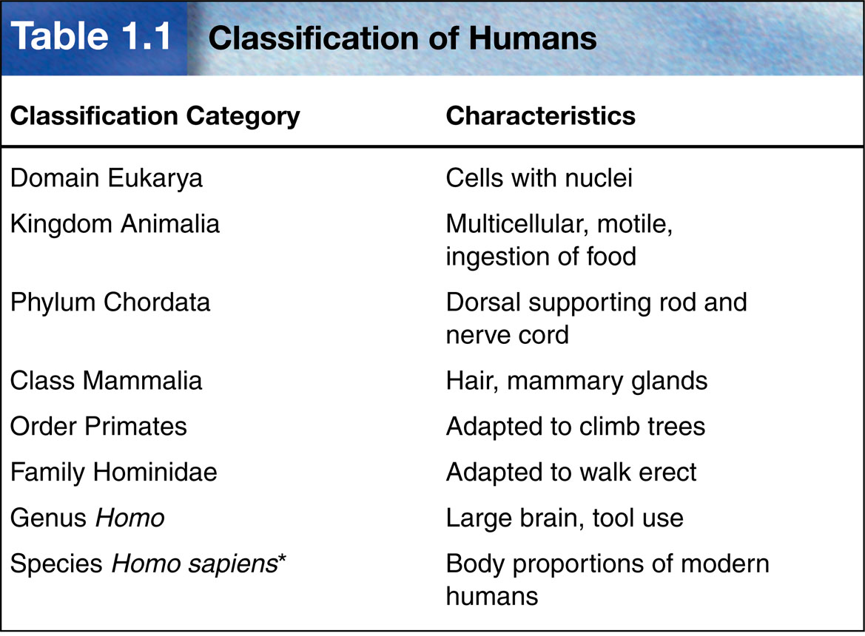

Slide 23
Domains
Broadest, most inclusive taxon
Three domains
Archaea and Bacteria are unicellular prokaryotes (no nucleus or membrane-bound organelles)
Eukarya are more complex and have a nucleus and membrane-bound organelles

Slide 24
ARCHAEA
Kingdom - ARCHAEBACTERIA
Probably the 1st cells to evolve
Live in HARSH environments
Found in:
Sewage Treatment Plants (Methanogens)
Thermal or Volcanic Vents (Thermophiles)
Hot Springs or Geysers that are acid
Very salty water (Dead Sea; Great Salt Lake) - Halophiles

Slide 25
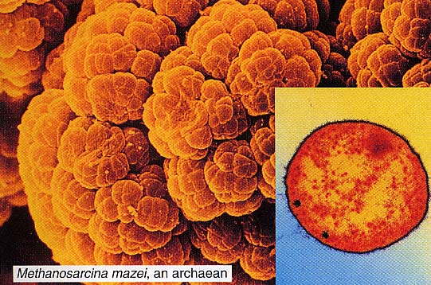
ARCHAEAN

Slide 26
BACTERIA
Kingdom - EUBACTERIA
Some may cause DISEASE
Found in ALL HABITATS except harsh ones
Important decomposers for environment
Commercially important in making cottage cheese, yogurt, buttermilk, etc.

Slide 27
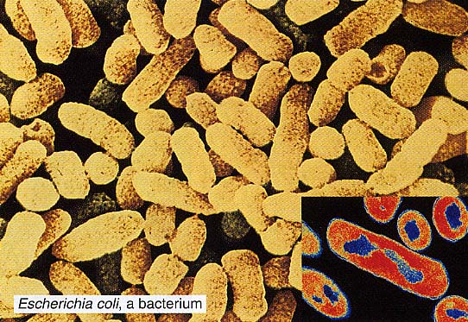
Live in the intestines of animals

Slide 28
Domain Eukarya is Divided into Kingdoms
Protista (protozoans, algae…)
Fungi (mushrooms, yeasts …)
Plantae (multicellular plants)
Animalia (multicellular animals)

Slide 29
Protista
Most are unicellular
Some are multicellular
Some are autotrophic, while others are heterotrophic
Aquatic

Slide 30
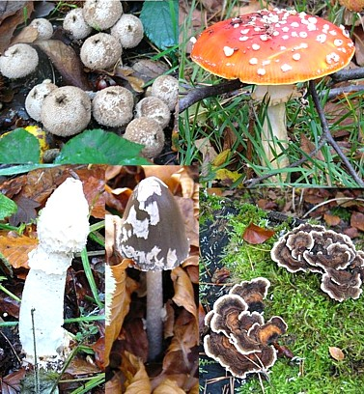
Fungi
Multicellular, except yeast
Absorptive heterotrophs (digest food outside their body & then absorb it)
Cell walls made of chitin

Slide 31
Plantae
Multicellular
Autotrophic
Absorb sunlight to make glucose – Photosynthesis
Cell walls made of cellulose
Notes:
Growth, with increases in size and number of cells, is part of development.
Development involves many stages from conception until death.

Slide 32
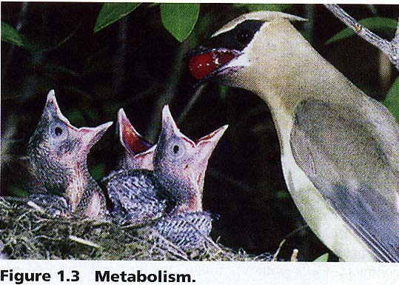
Animalia
Multicellular
Ingestive heterotrophs (consume food & digest it inside their bodies)
Feed on plants or animals

Slide 33
Basis for Modern Taxonomy
Homologous structures (same structure, different function)
Similar embryo development
Molecular Similarity in DNA, RNA, or amino acid sequence of Proteins

Slide 34
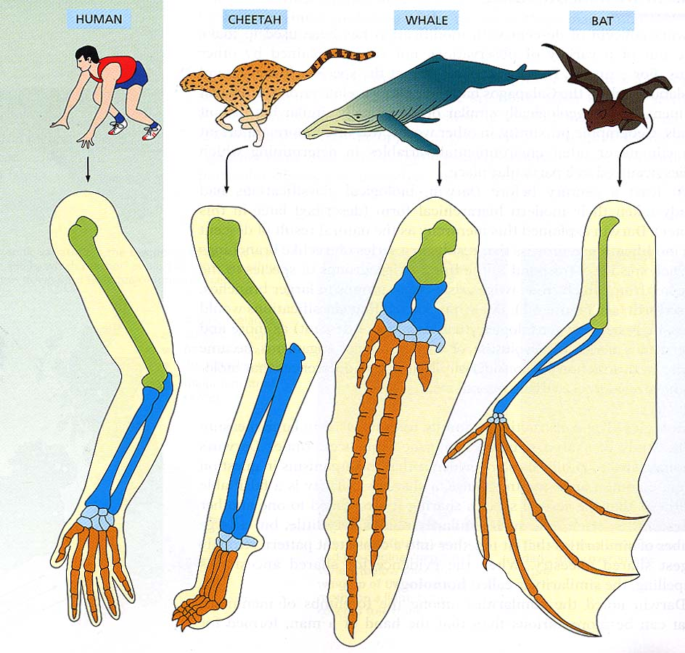
Homologous Structures (BONES in the FORELIMBS) shows Similarities in mammals.

