Slide 1
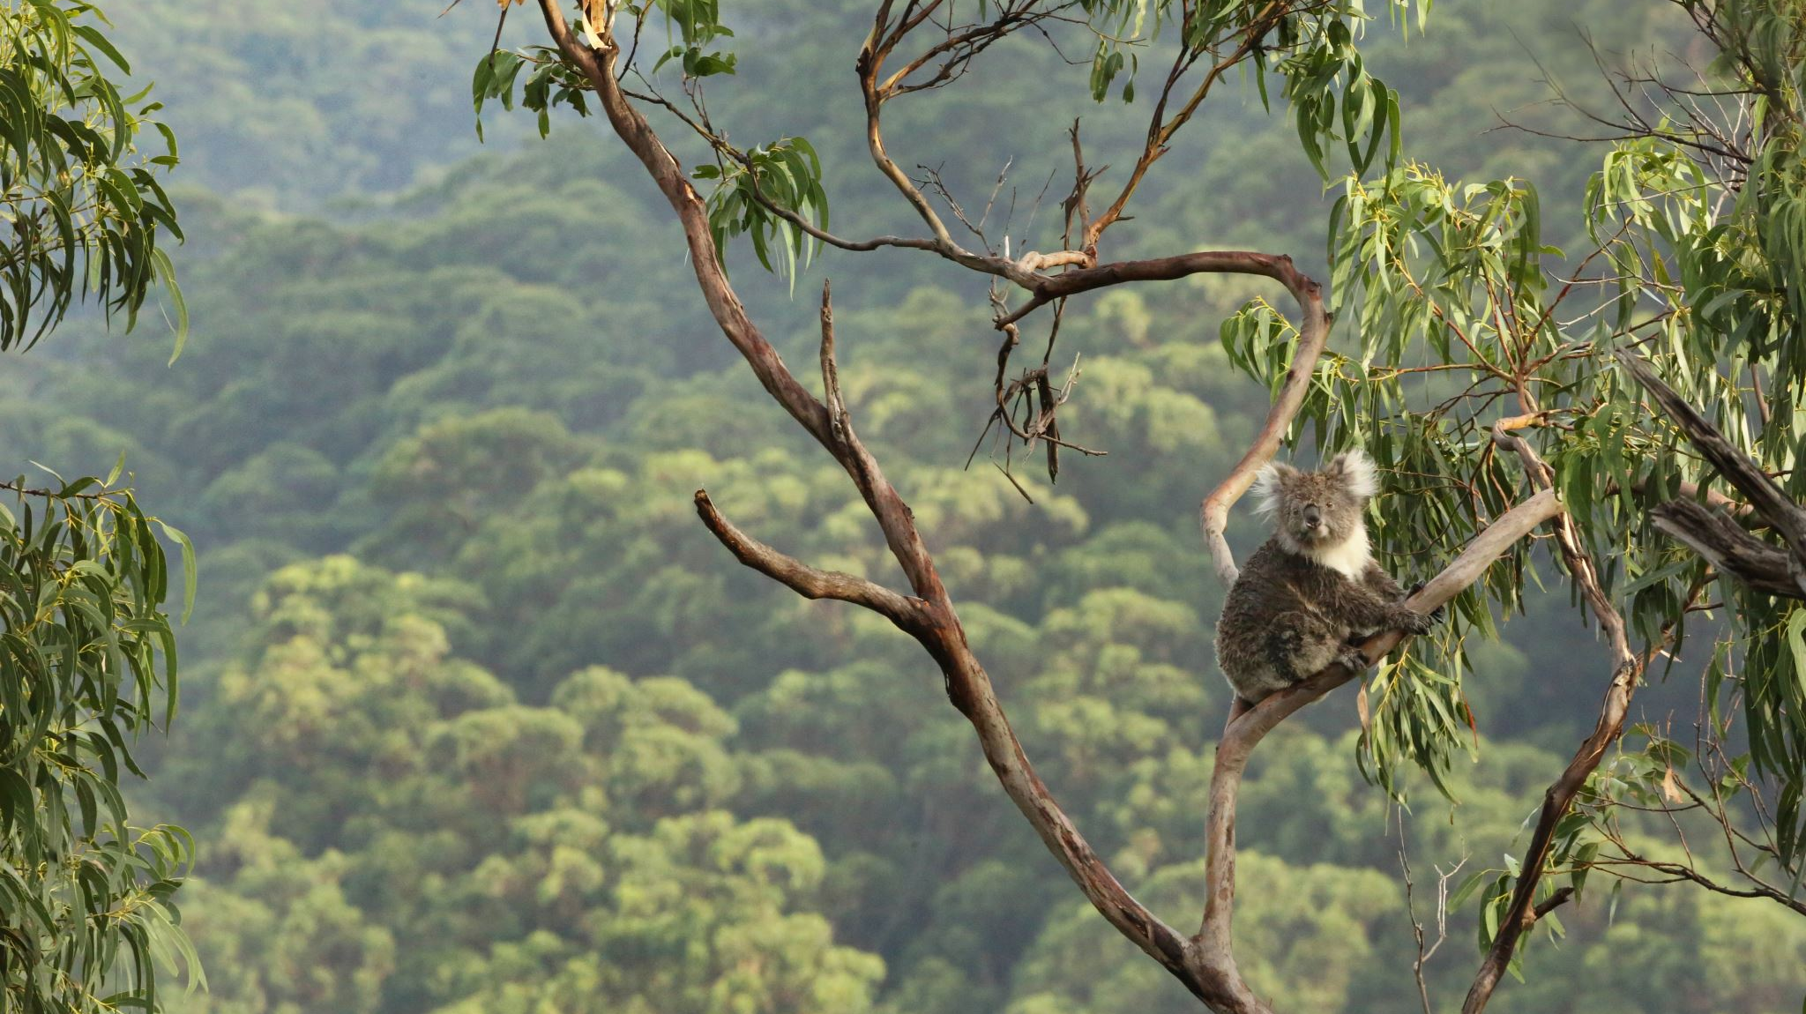
COMMUNITIES AND ECOSYSTEM DYNAMICS
Chapter 6

Slide 2
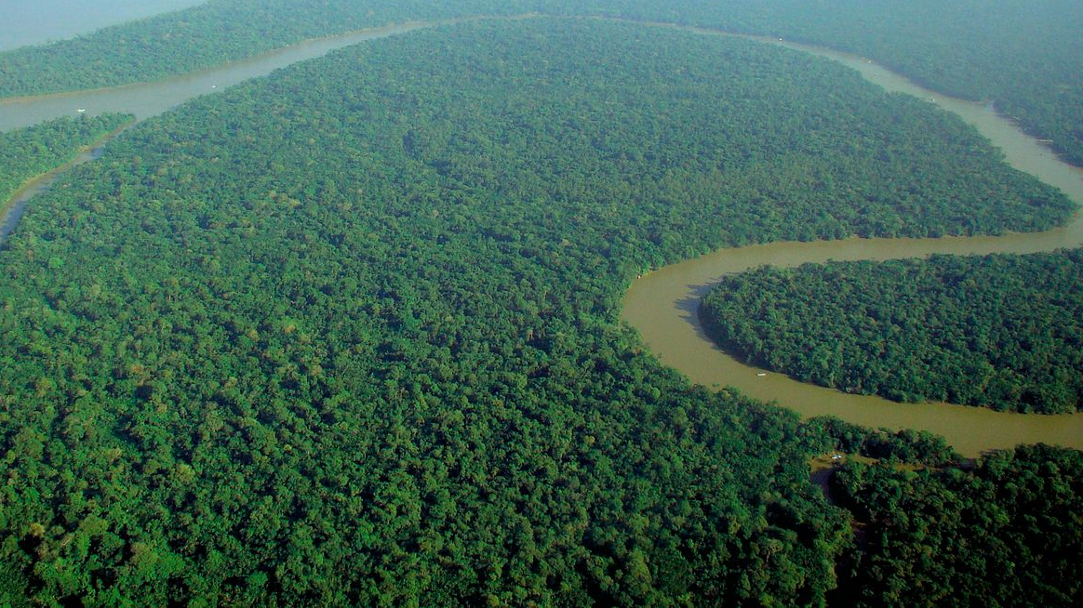
Habitats
This Photo by Unknown Author is licensed under CC BY-SA
This Photo by Unknown Author is licensed under CC BY-SA

Slide 3
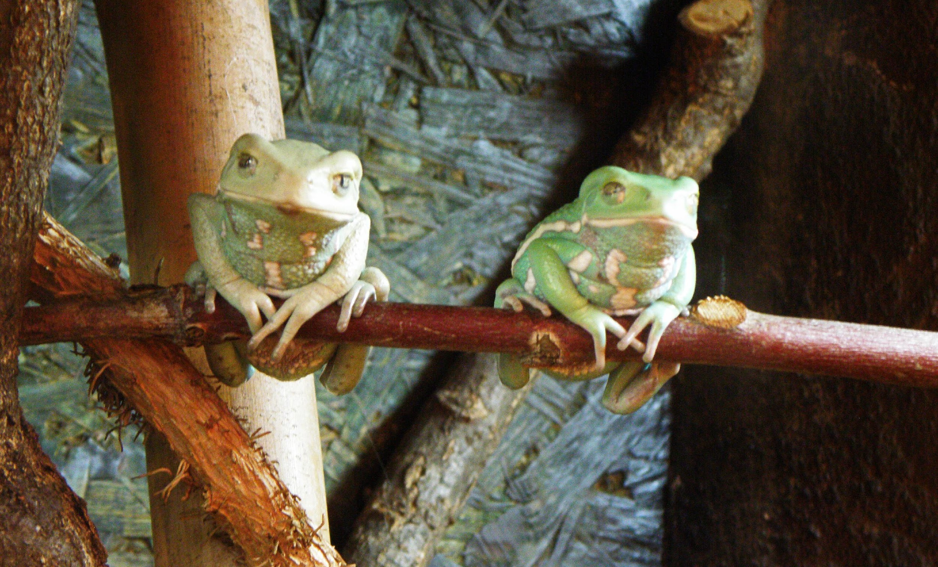
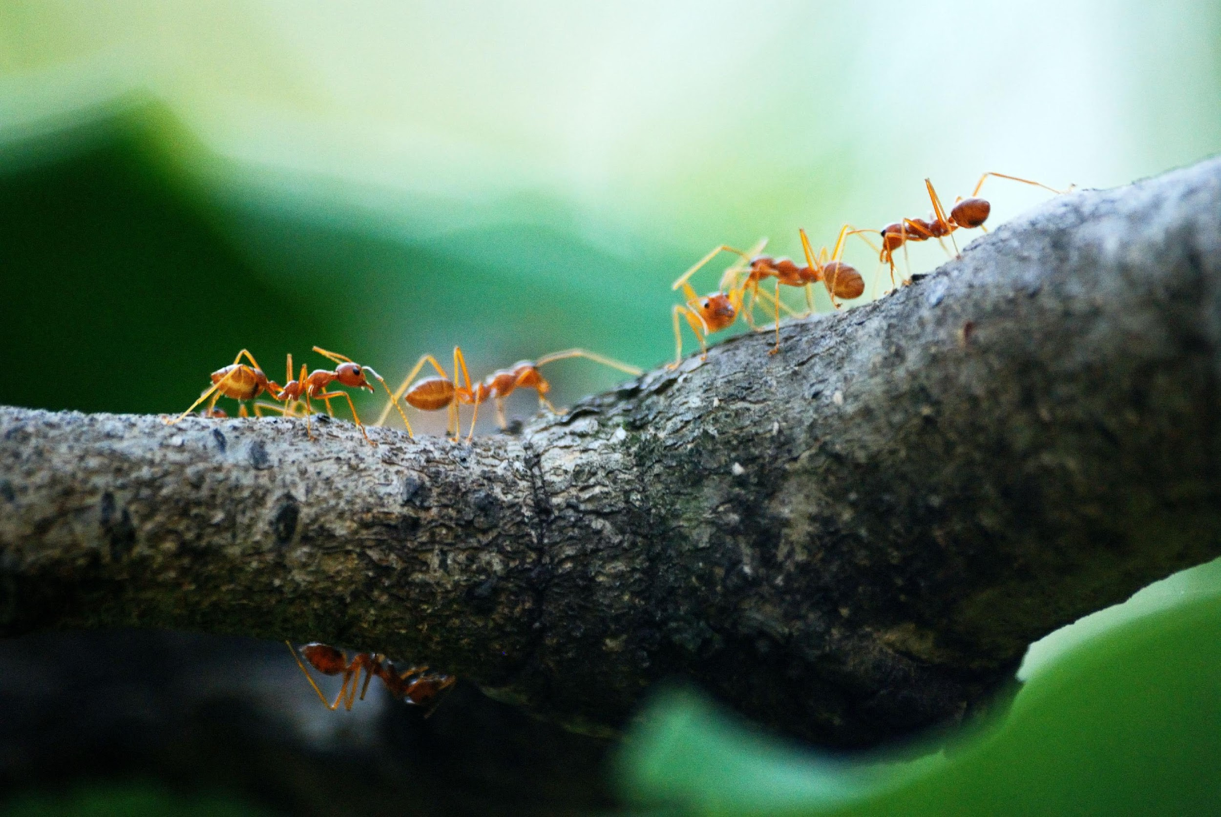
Niche
This Photo by Unknown Author is licensed under CC BY-SA

Slide 4
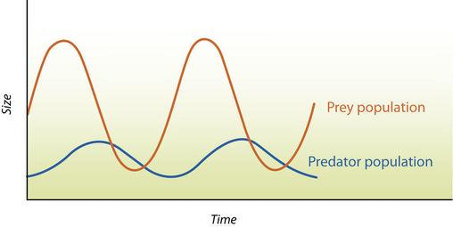
COMPETITIVE EXCLUSION PRINCIPLE PREDATOR VS PREY

Slide 5
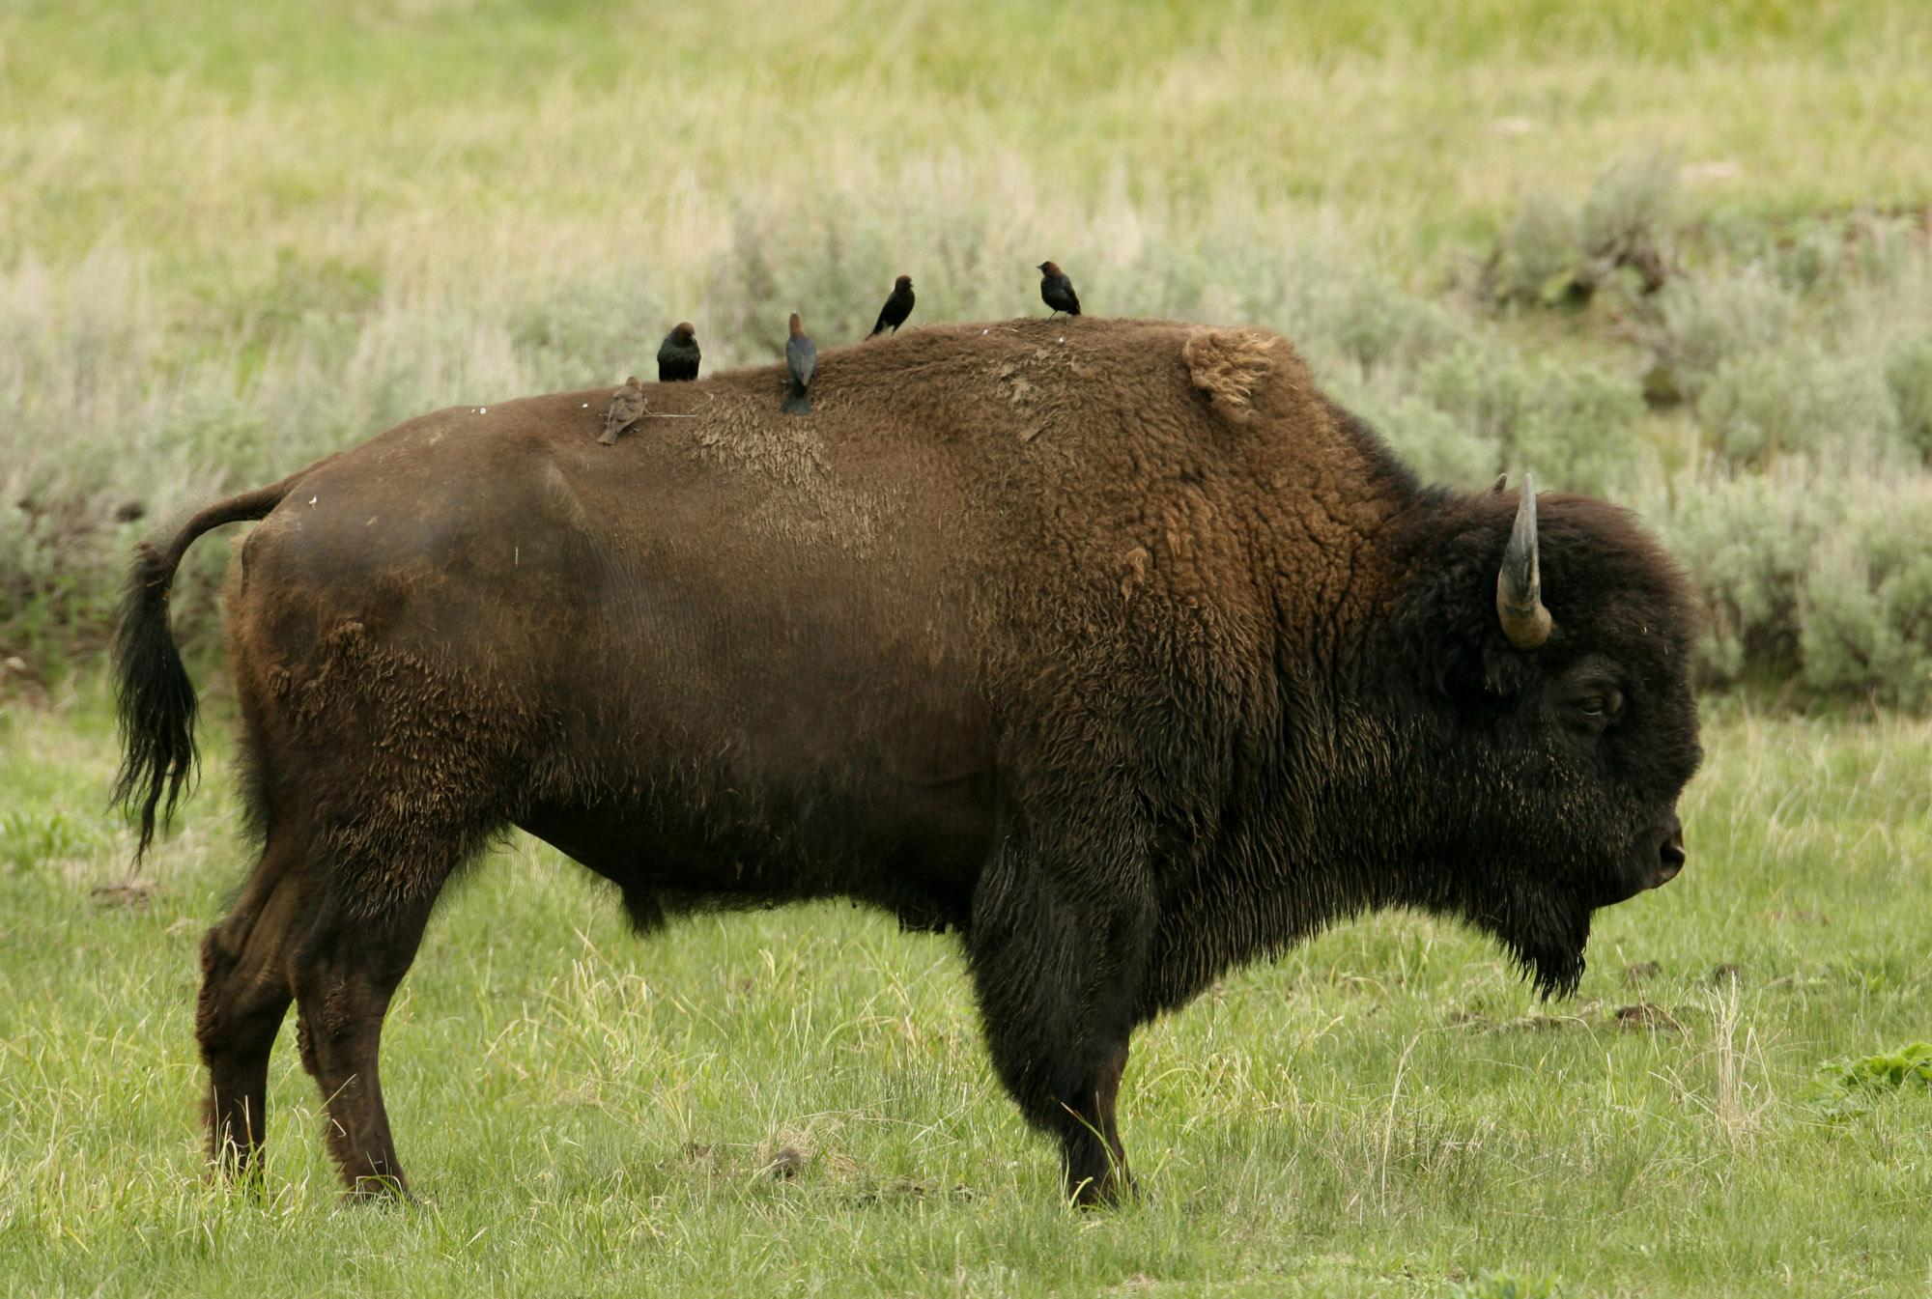
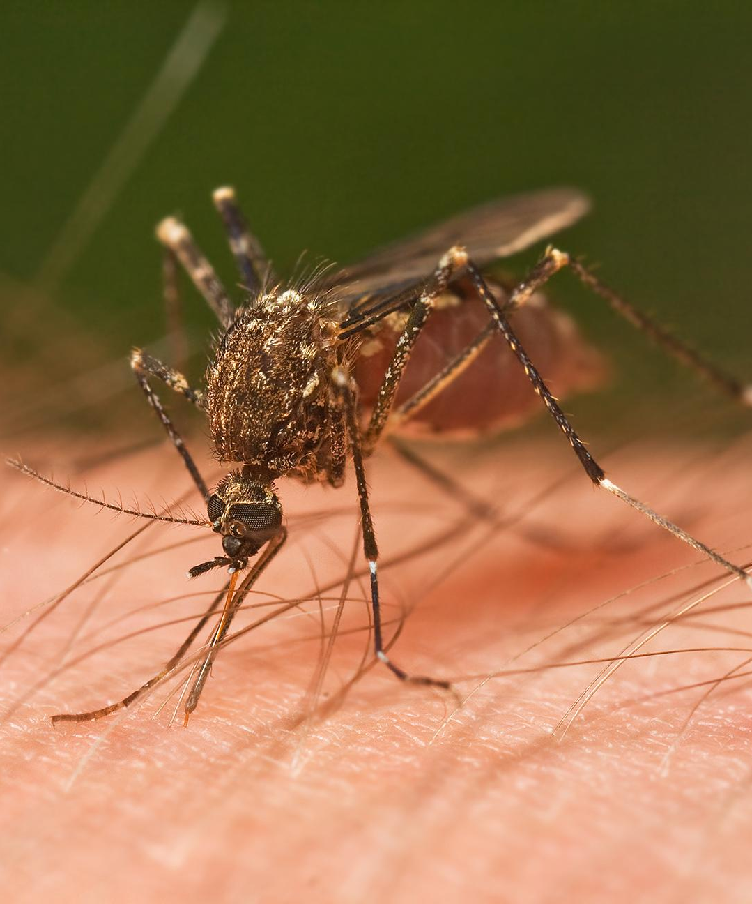
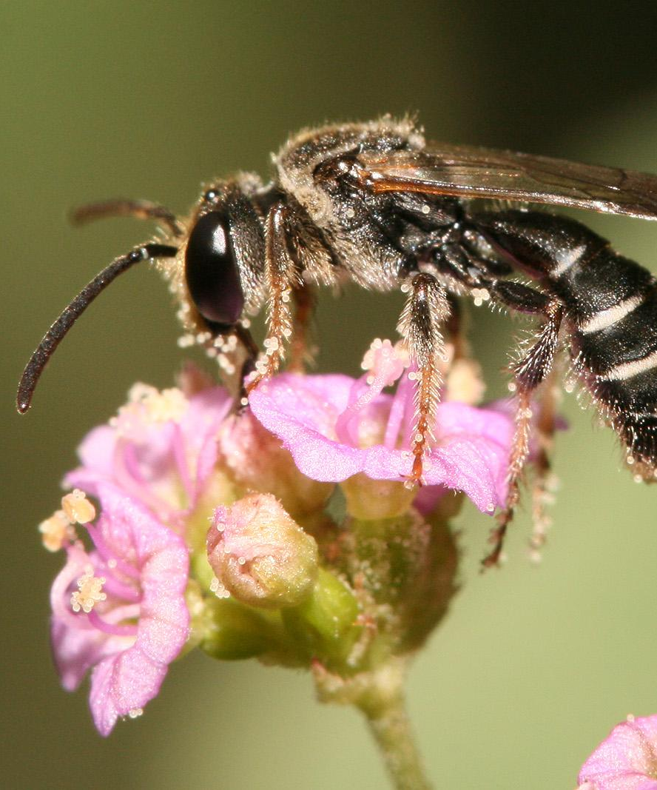
Symbiosis
Mutualism(+,+)
Commensalism(+,0)
Parasitism(+,-)
This Photo by Unknown Author is licensed under CC BY-SA
This Photo by Unknown Author is licensed under CC BY-SA
This Photo by Unknown Author is licensed under CC BY-SA

Slide 6
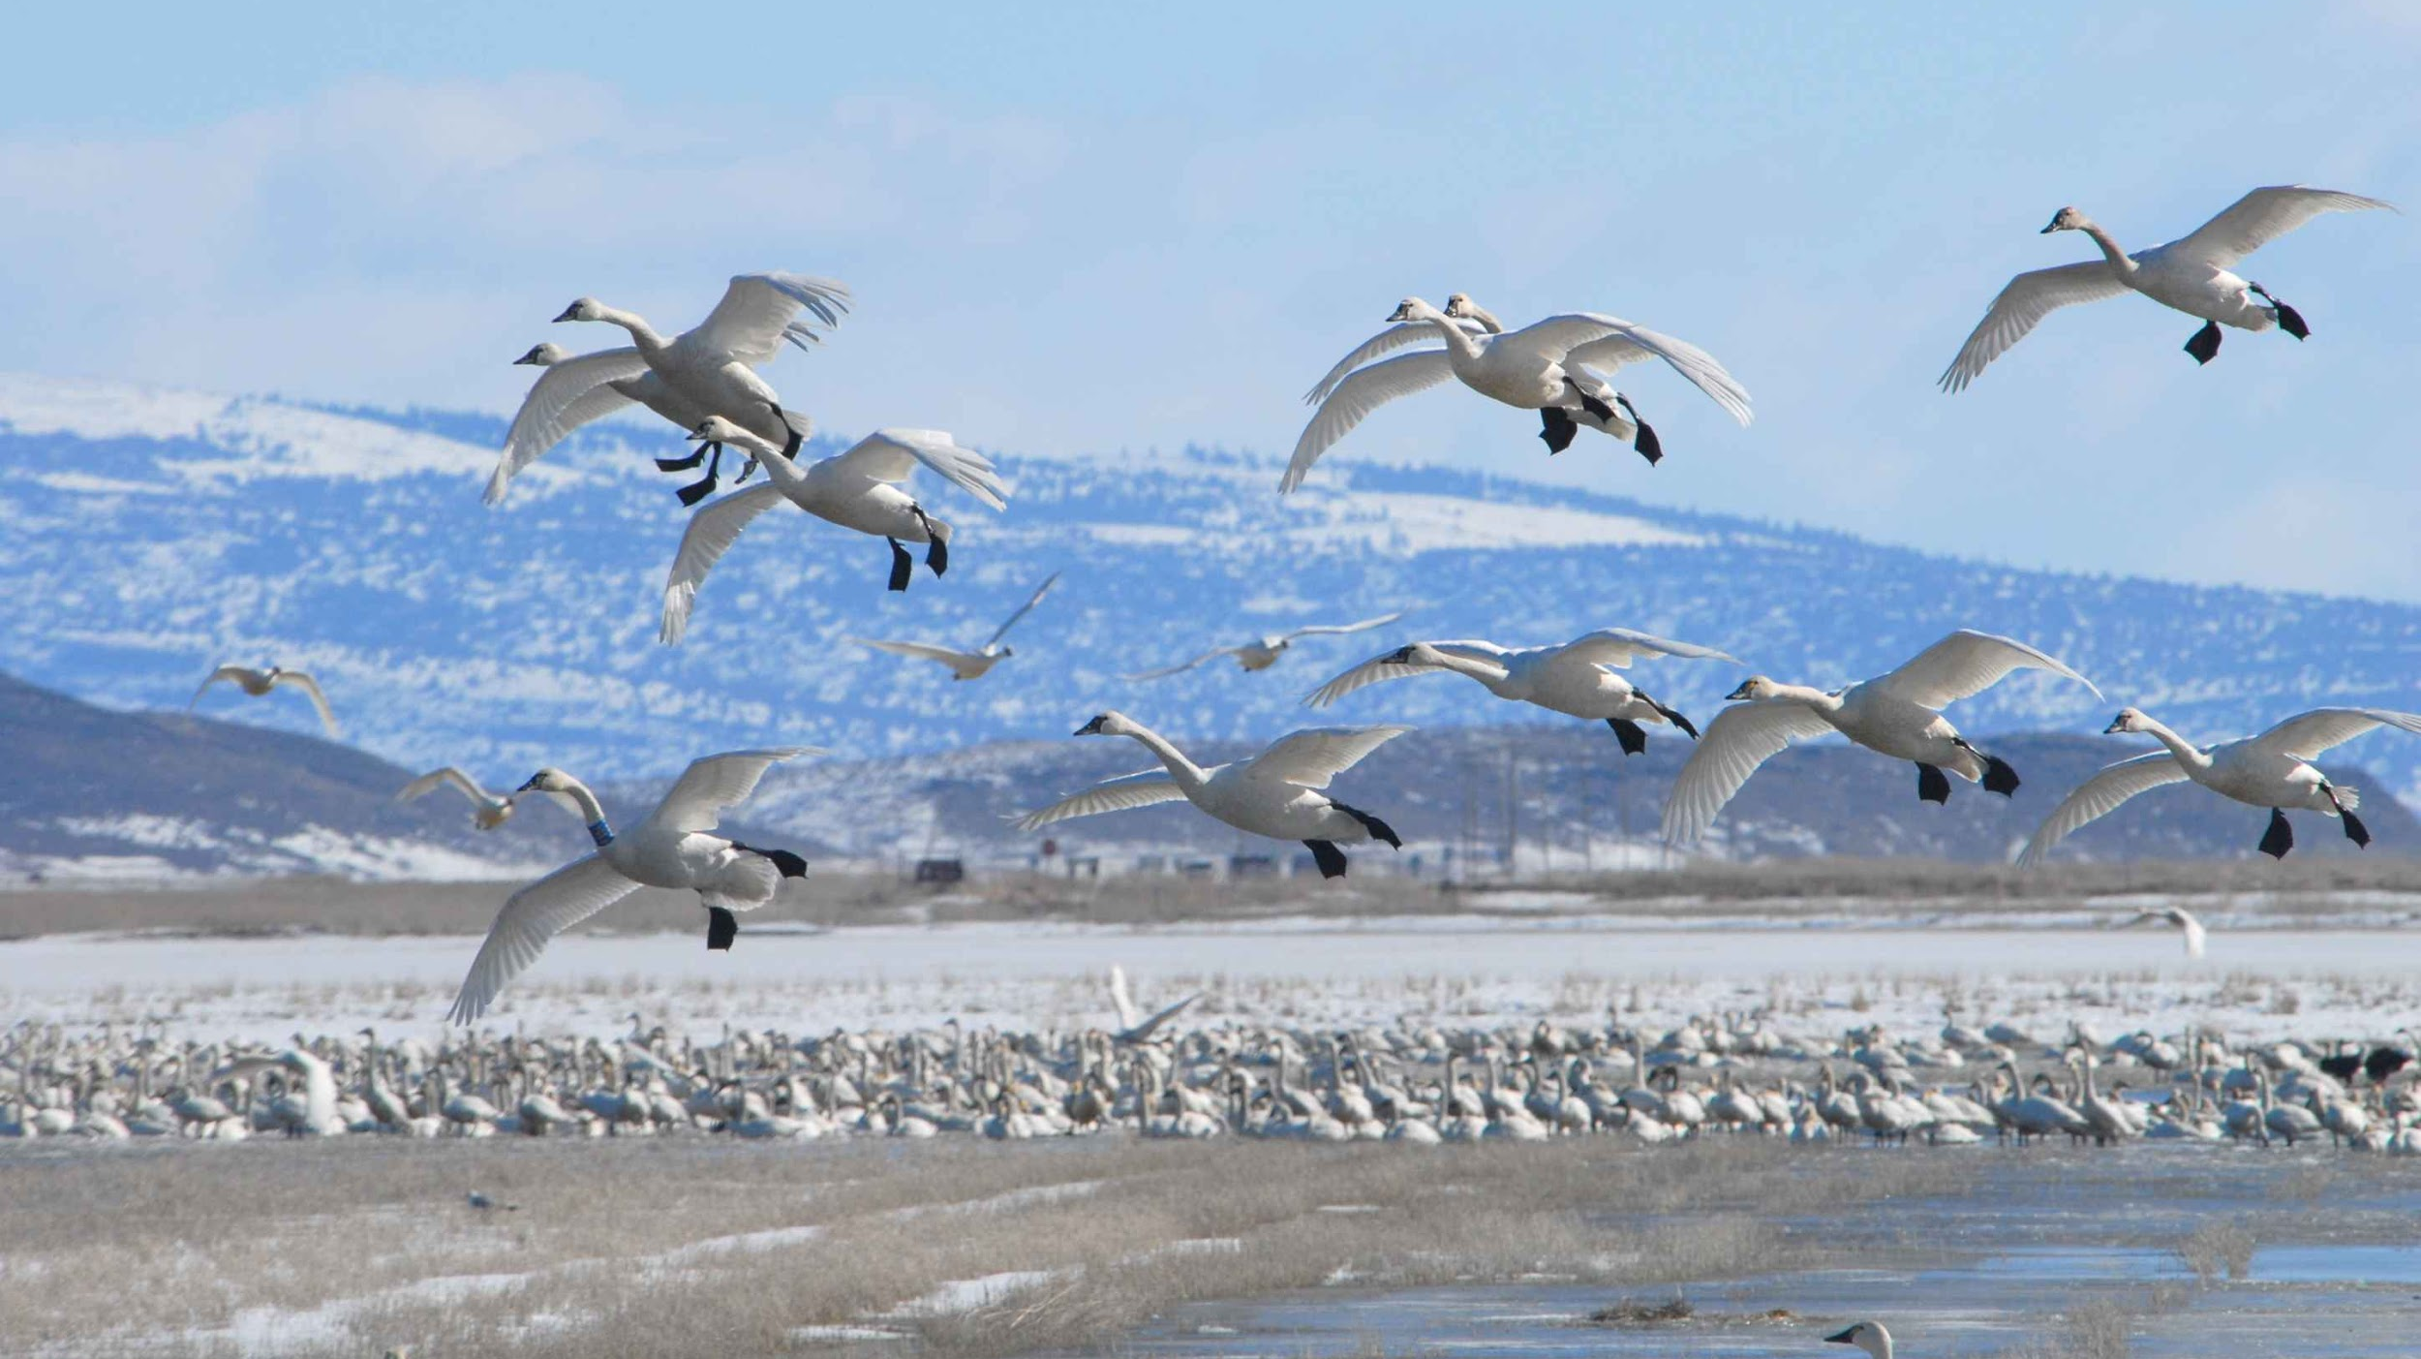
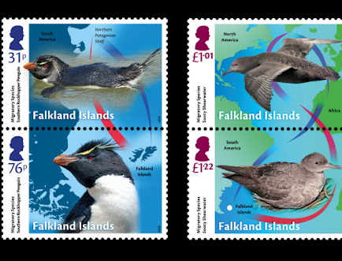
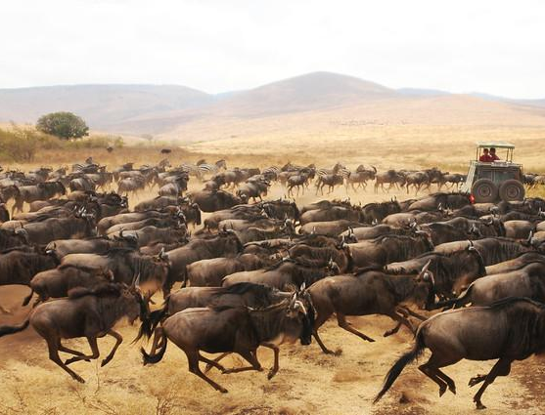
Tolerence
This Photo by Unknown Author is licensed under CC BY

Slide 7
This Photo by Unknown Author is licensed under CC BY
Keystone species:

Slide 8
Youtube: death of bees, colony collapse

Slide 9
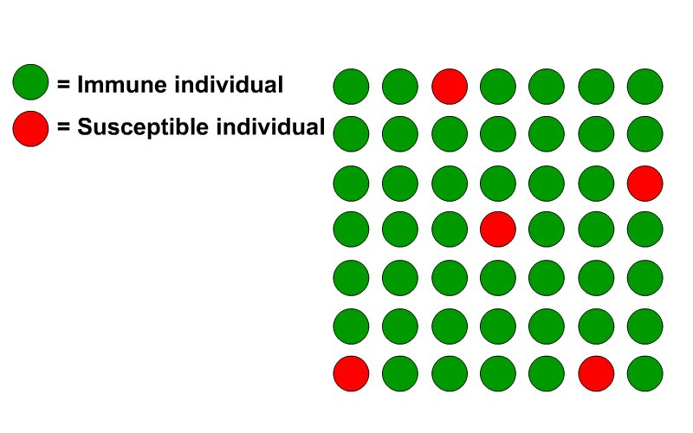
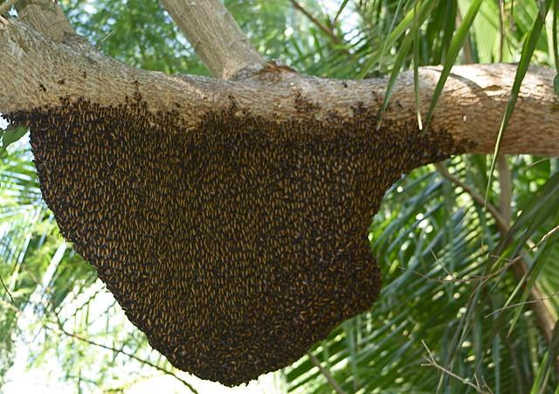
Genetic Diversity
Think-pair-share
What is the importance of biodiversity?
This Photo by Unknown Author is licensed under CC BY-SA-NC
This Photo by Unknown Author is licensed under CC BY-NC

Slide 12
SUCCESSION AND PIONEER SPECIES
This Photo by Unknown Author is licensed under CC BY-SA
This Photo by Unknown Author is licensed under CC BY

